Slide 1
Chapter 1

Slide 2
Developer 1
merge changes
shared
codebase
Developer 2
merge changes
Developer N
merge changes

Slide 3
dev
test
prod

Slide 4
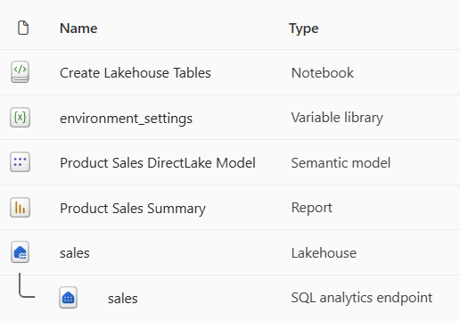
solution workspace

Slide 5
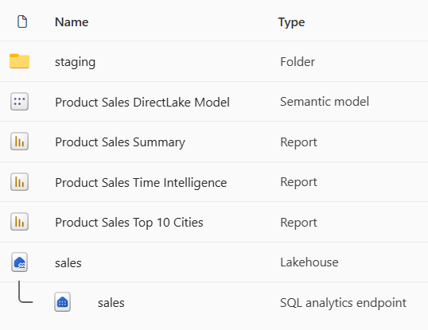
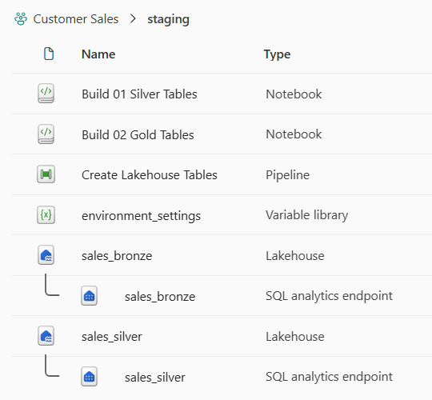
presentation workspace
staging workspace

Slide 6
dev environment
test environment
prod environment

Slide 7
dev environment
test environment
prod environment
Fabric Workspace
Fabric Workspace
Fabric Workspace
Fabric capacity (F4)
Fabric capacity (F16)
Fabric capacity (F64)

Slide 8
dev environment
test environment
prod environment
Fabric Workspace
Fabric Workspace
Fabric Workspace
Fabric capacity (F4)
Fabric capacity (F16)
Fabric capacity (F64)
Azure Storage Account
used to store dev data files
Azure Storage Account
used to store test data files
Azure Storage Account
used to store prod data files
Fabric Connection
to dev storage account
Fabric Connection
to test storage account
Fabric Connection
to prod storage account

Slide 9
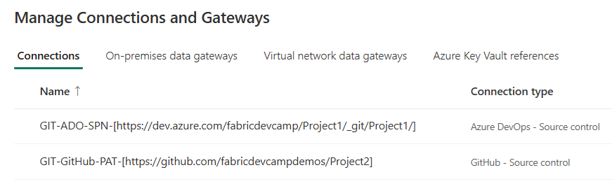

Slide 10
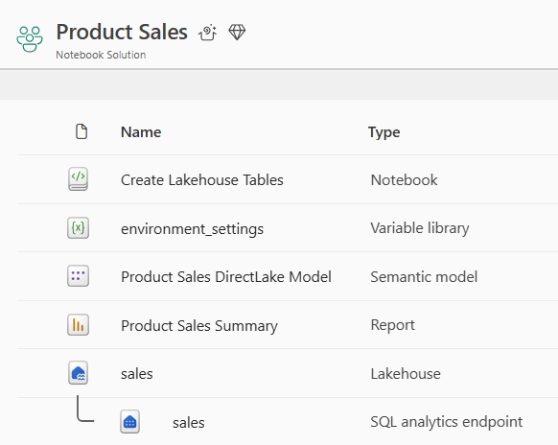
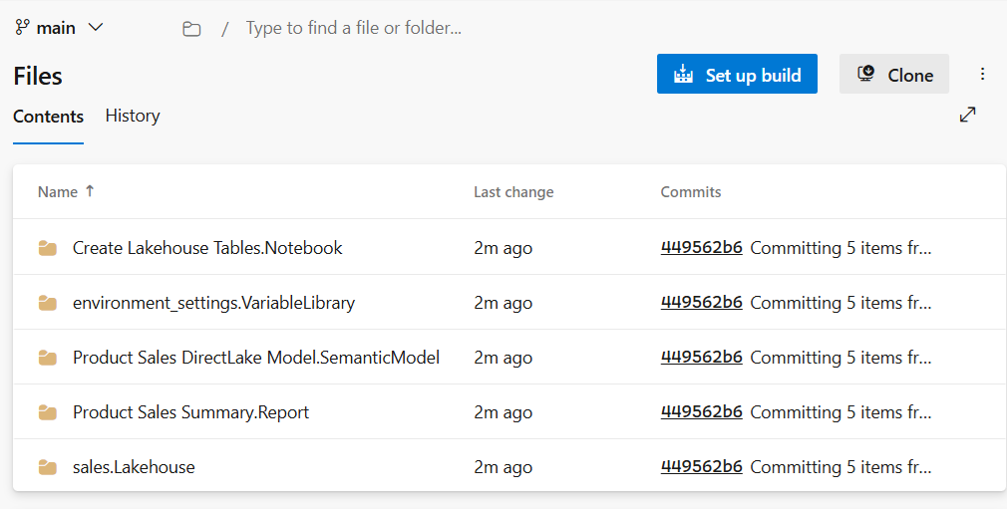
Commit to GIT

Slide 11
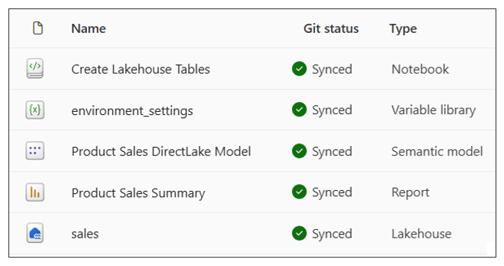

Slide 12
workspace
Update from GIT
GIT
branch

Slide 13
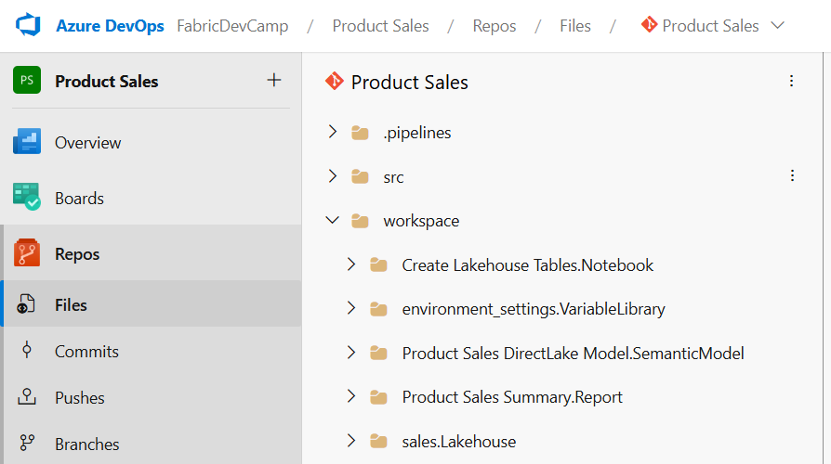

Slide 14
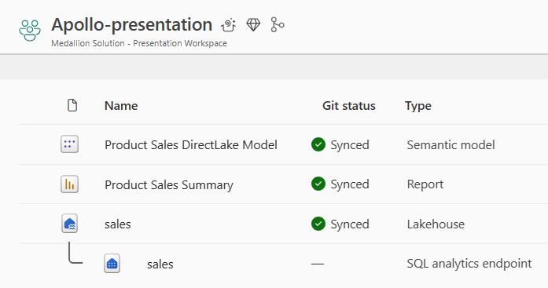
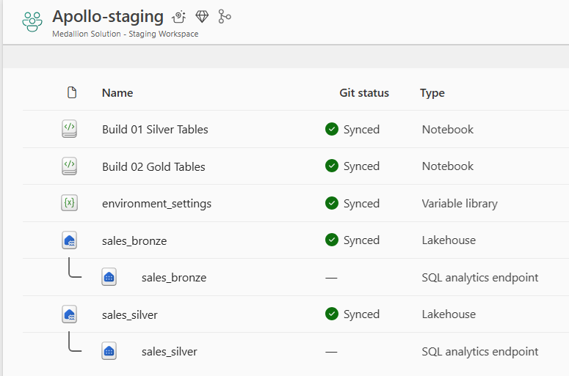
Fabric solution design with Medallion architecture

Slide 15
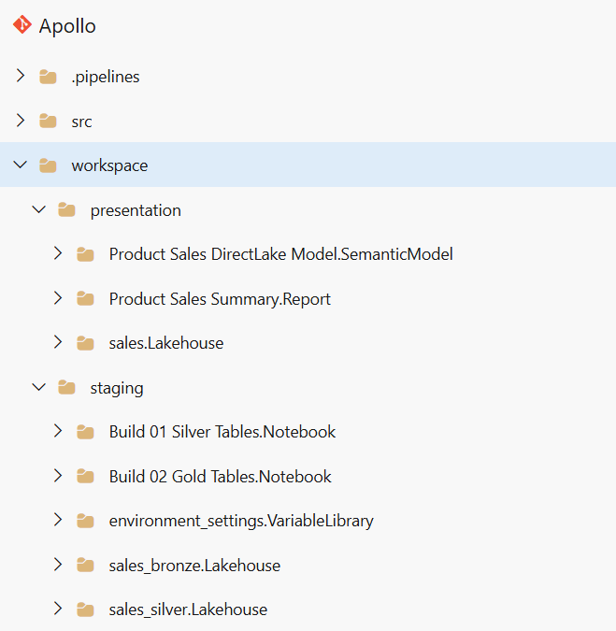

Slide 16
feature
branch
Pull Request
integration
branch

Slide 17
dev
workspace
Commit to GIT
integration
branch

Slide 18
integration
branch
feature
branch
Update from GIT
feature
workspace
Create Branch

Slide 19
feature_1
workspace
Commit to GIT
feature_1
branch
Pull Request
integration
branch
feature_2
workspace
Commit to GIT
feature_2
branch
Pull Request
feature_N
workspace
Commit to GIT
feature_N
branch
Pull Request

Slide 20
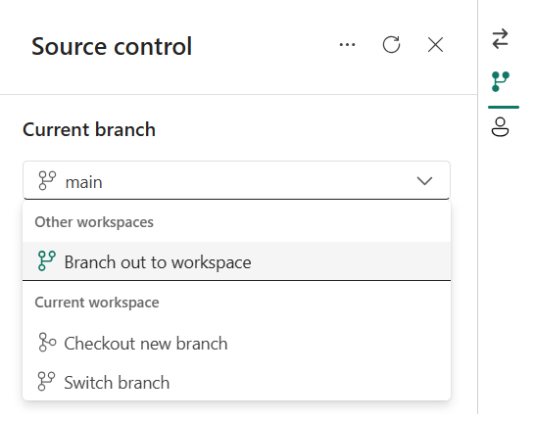

Slide 21
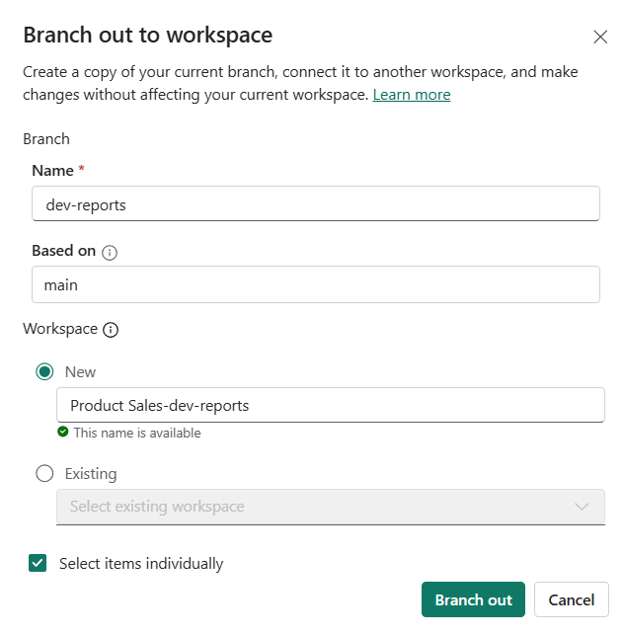

Slide 22
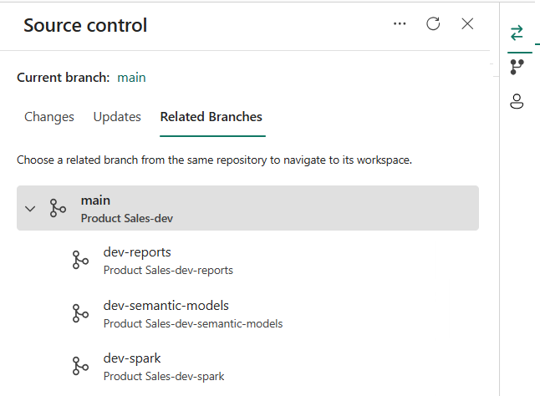
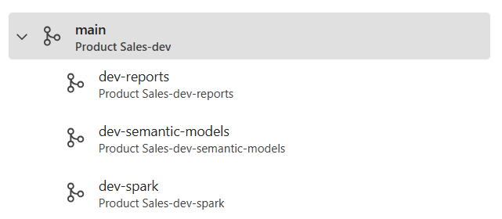

Slide 24
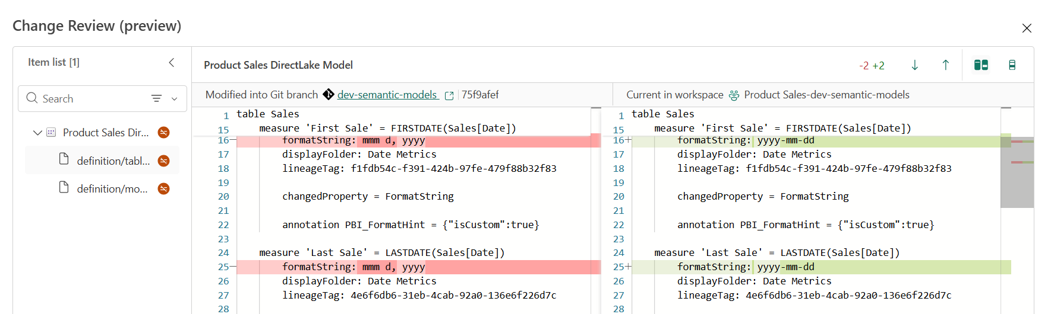

Slide 25
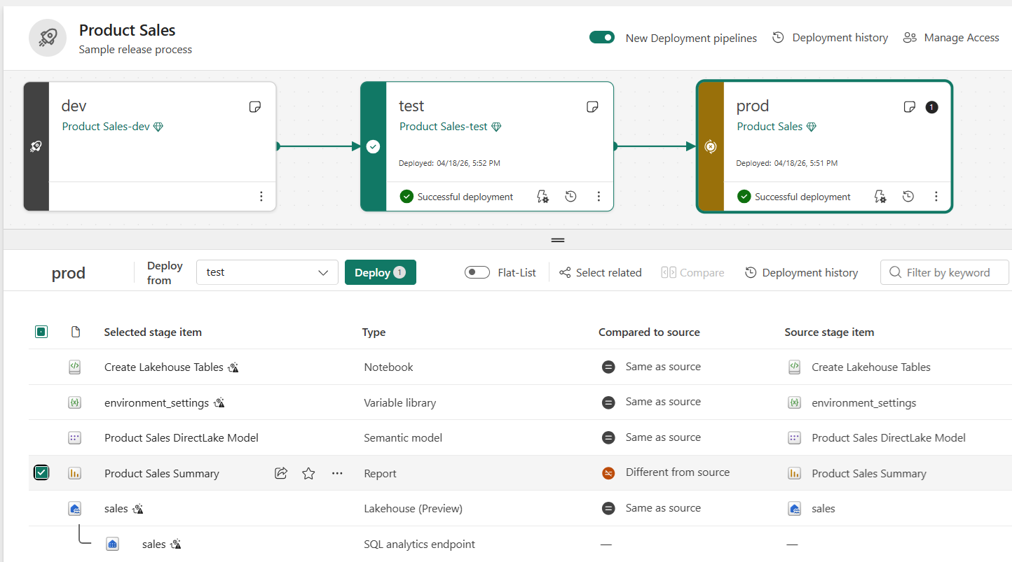

Slide 26
workspace
Notebook
Pipeline
Variable Library
Copyjob
var1 - string - 'foo'
var2 - string - 'bar'
var3 - integer - 42
Dataflow
Lakehouse Shortcut

Slide 27
dev
workspace
test
workspace
prod
workspace

Slide 28
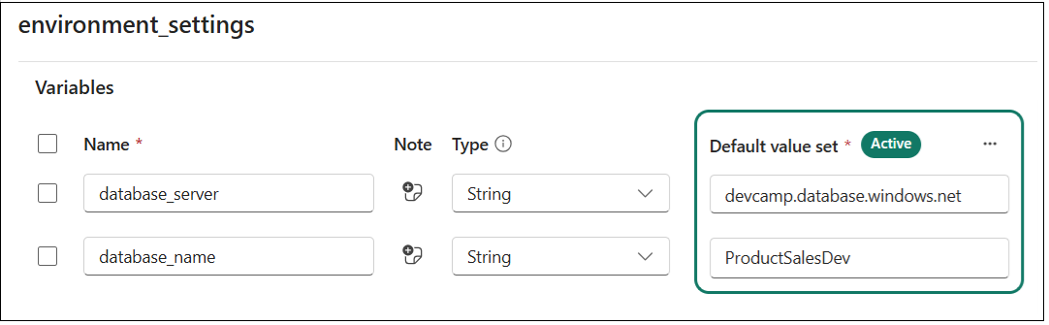

Slide 29
Variable Name | Type | Default Value
database_server | String | devcamp.database.windows.net
database_name | String | product-sales-dev

Slide 30
Variable Library
Value Sets
Variable Name | Type | Default Value
database_server | String | dev value
database_name | String | dev value
test
test value
test value
prod
prod value
prod value

Slide 31
dev workspace
test workspace
prod workspace
Variable Library
Variable Library
Variable Library
default value set (active)
test value set
prod value set
default value set
test value set (active)
prod value set
default value set
test value set
prod value set (active)

Slide 32





Fabric Solution
Variable Library
Lakehouse
Notebook
Semantic Model
Report

Slide 33

dev workspace
Notebook
Lakehouse
Pipeline

Slide 34
dev workspace
feature workspace
Notebook
Notebook
Lakehouse
Pipeline
Lakehouse
Pipeline
Commit
to GIT
Update
from GIT
integration
branch
Create Branch
feature
branch

Slide 35
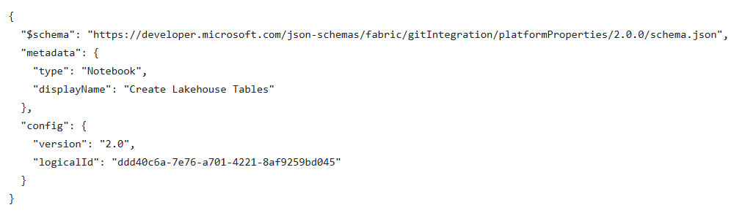

Slide 36
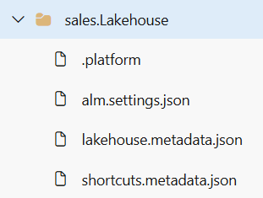

Slide 37
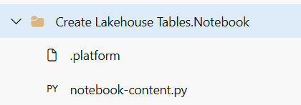
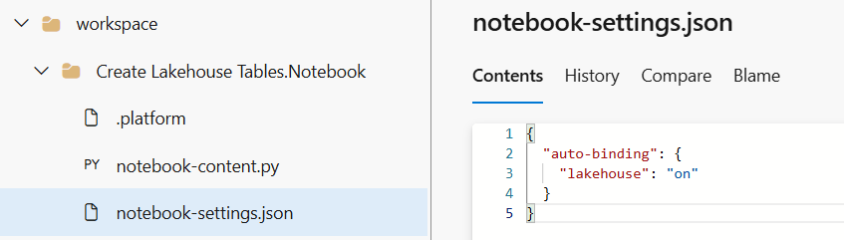

Slide 38
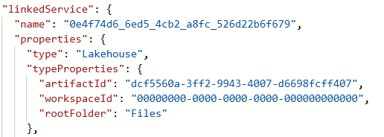

Slide 39
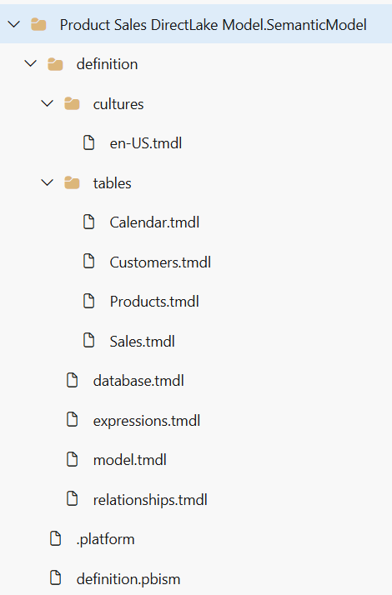

Slide 40
Terraform
Fabric CLI
fabric-cicd
.NET SDK
Python SDK
Fabric REST APIs

Slide 41
integration
branch
feature
branch
Update from GIT
feature
workspace
Create Branch

Slide 42
feature
workspace
Commit to GIT
feature
branch
Pull Request
integration
branch
Update from GIT
dev
workspace

Slide 43
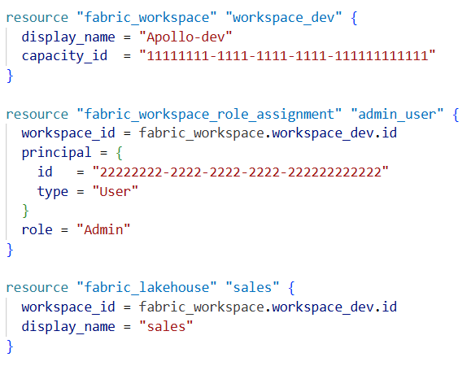
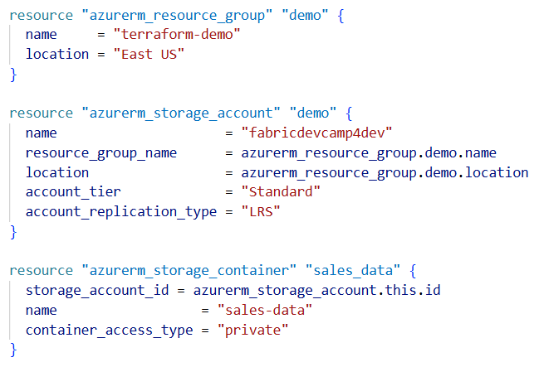
Your Terraform Configuration
Terraform
Terraform provider for Fabric (fabric)
Terraform provider for Azure (azurerm)
Fabric REST APIs
Azure REST APIs

Slide 44
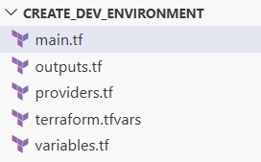

Slide 45
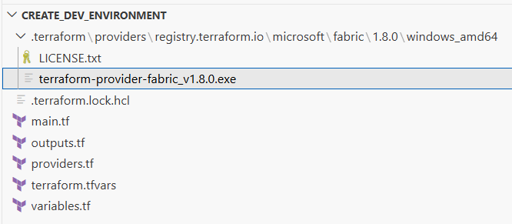

Slide 46
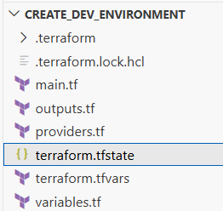
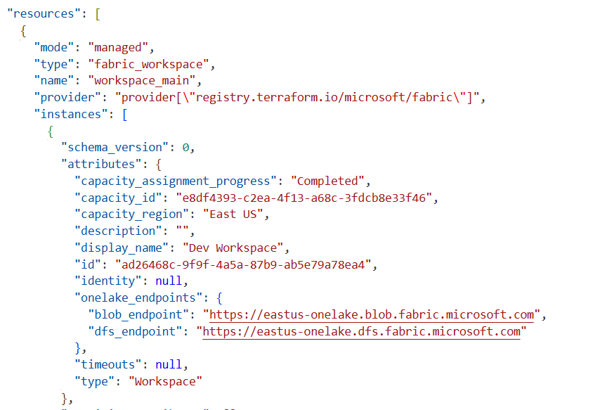

Slide 47
dev environment
test environment
prod environment
Fabric Workspace
Fabric Workspace
Fabric Workspace
Fabric capacity (F4)
Fabric capacity (F16)
Fabric capacity (F64)
Azure Storage Account
used to store dev data files
Azure Storage Account
used to store test data files
Azure Storage Account
used to store prod data files
Fabric Connection
to dev storage account
Fabric Connection
to test storage account
Fabric Connection
to prod storage account

Slide 48
Development Process (CI)
Release Process (CD)
Dev
workspace
Test
workspace
?
feature
workspace
feature
branch
integration
branch
Prod
workspace
feature
workspace
feature
branch

Slide 49
Fabric Deployment Pipeline
dev
workspace
Deploy
test
workspace
Deploy
prod
workspace
GIT
sync
main
branch

Slide 50
dev
workspace
test
workspace
prod
workspace
Update
from GIT
Update
from GIT
Update
from GIT
dev
branch
Pull Request
test
branch
Pull Request
main
branch

Slide 51
custom code for
release process
1. Call Update from GIT
prod
workspace
2. Run post-sync operations

Slide 52
dev
workspace
test
workspace
prod
workspace
Update
from GIT
fabric-cicd
fabric-cicd
dev
branch
Pull Request
test
branch
Pull Request
main
branch

Slide 53
dev
workspace
Update
from GIT
main
branch
test
workspace
fabric-cicd
fabric-cicd
prod
workspace

Slide 54
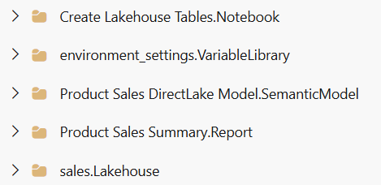
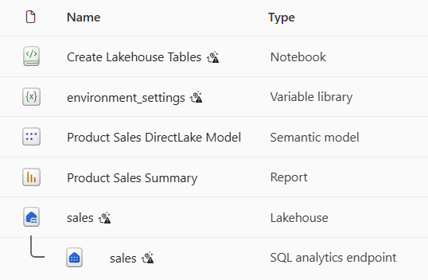
Folder with Item Definitions
fabric-cicd processing
target workspace
Create or Update Item
Create or Update Item
Create or Update Item
Create or Update Item
Create or Update Item

Slide 55
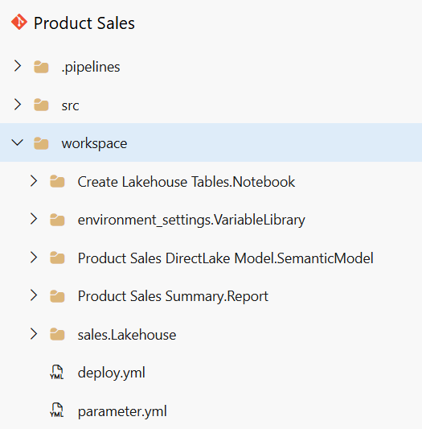

Slide 57
Your Code
Item
Definition
Fabric
REST
APIs
Create Item
Item
Definition
Update Item Definition
Item
Definition
Get Item Definition

Slide 58
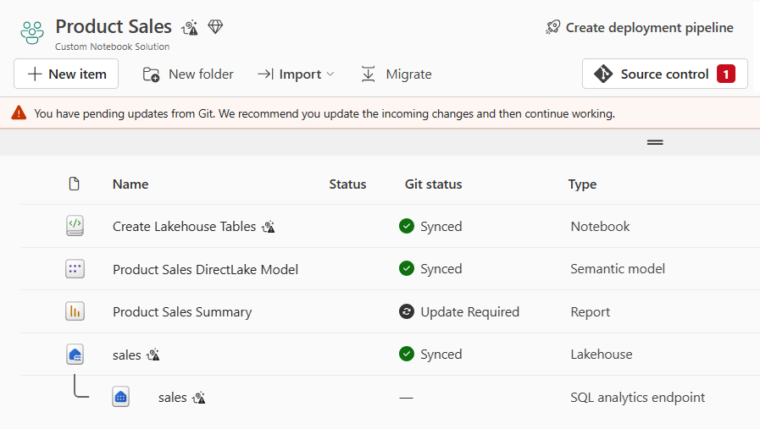

Slide 59
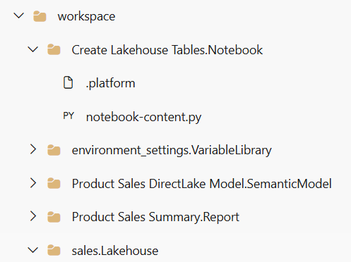
GIT branch
target workspace
API-driven
release process

Slide 60
dev
workspace
GIT Sync
release
branch
test
workspace
fabric-cicd
prod
workspace
fabric-cicd

Slide 61
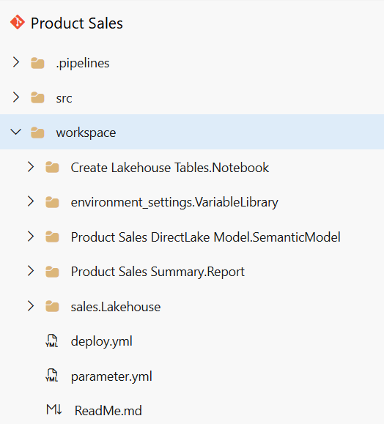

Slide 62
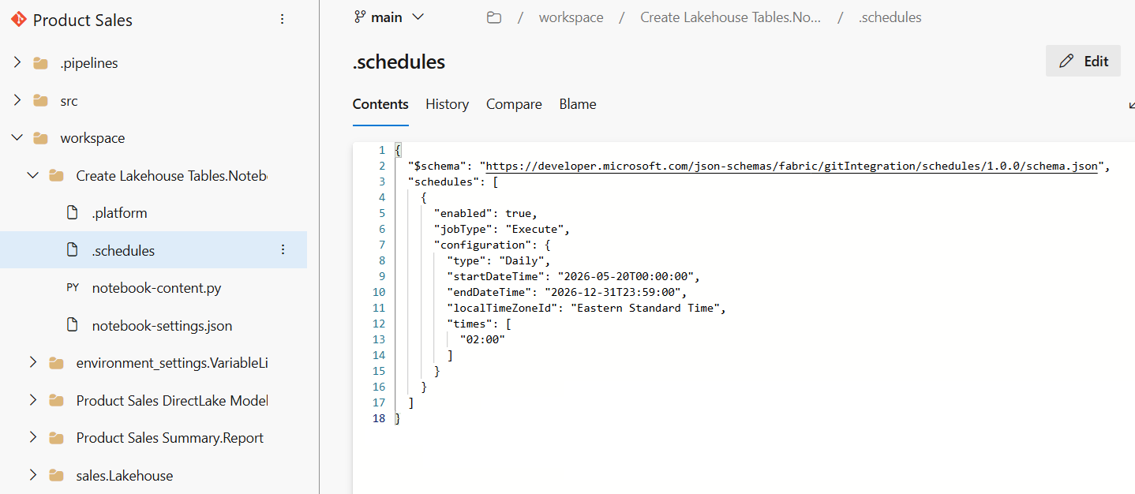

Slide 63
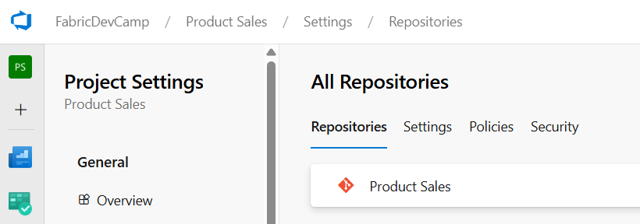

Slide 64
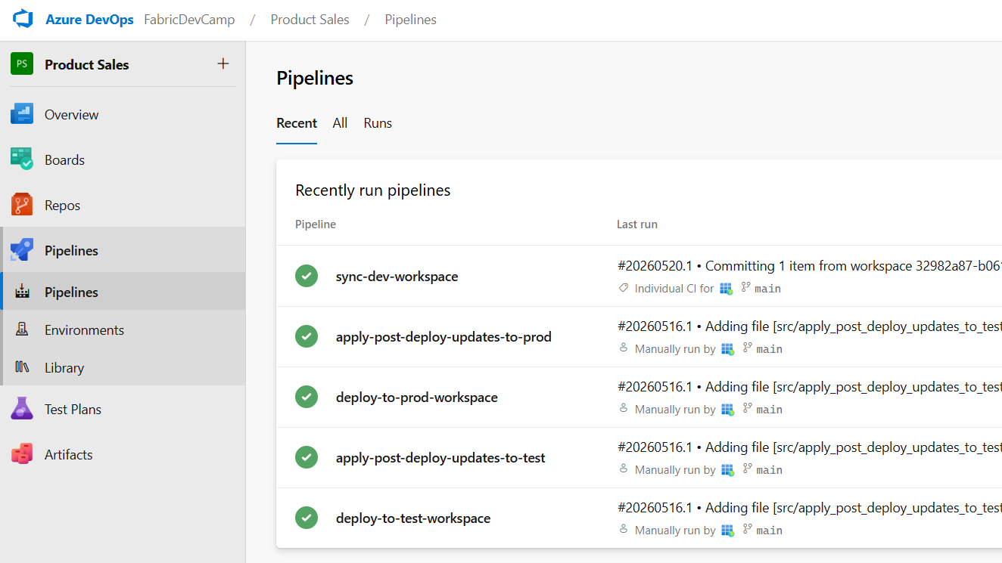

Slide 65
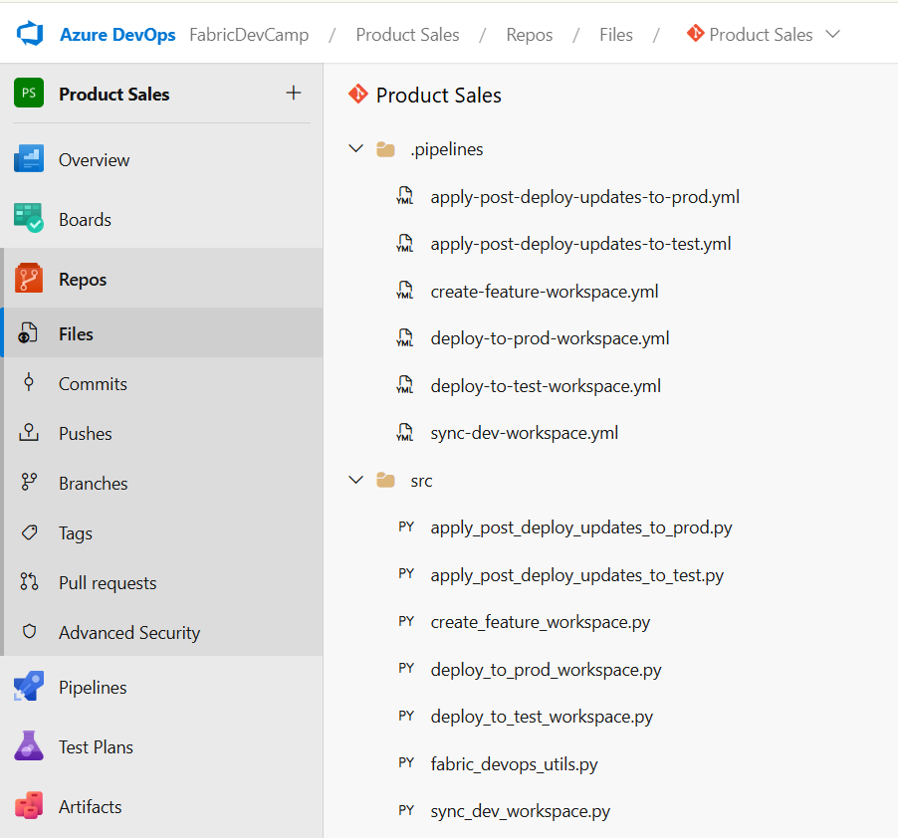

Slide 66
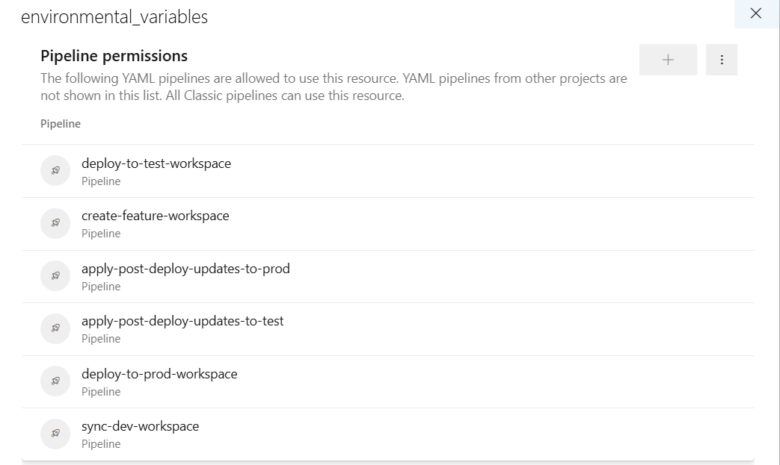

Slide 67
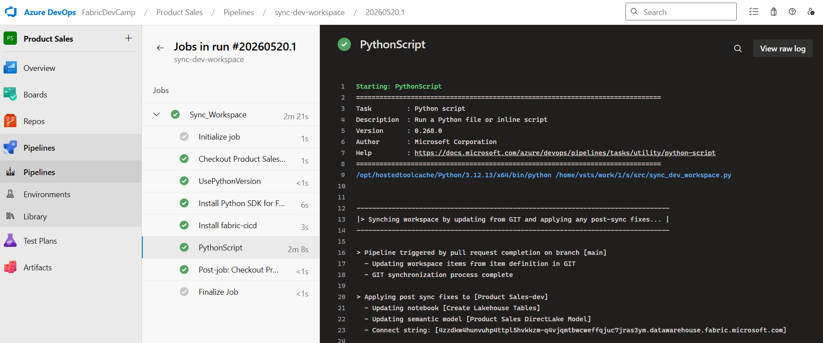

Slide 68
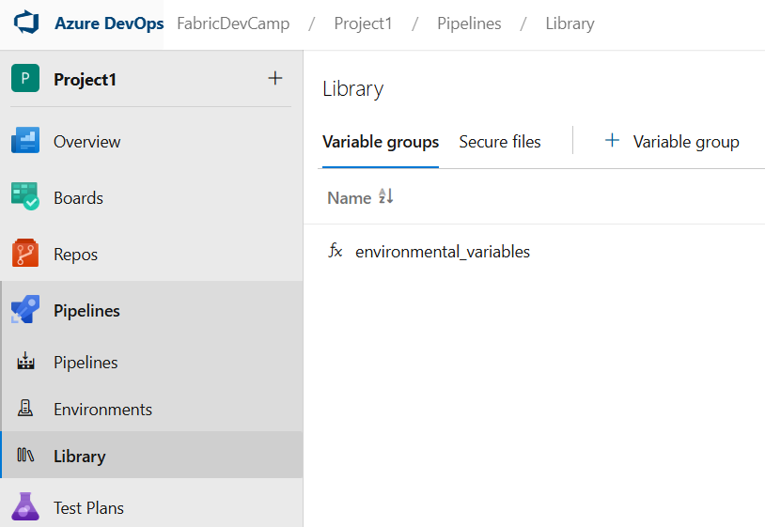
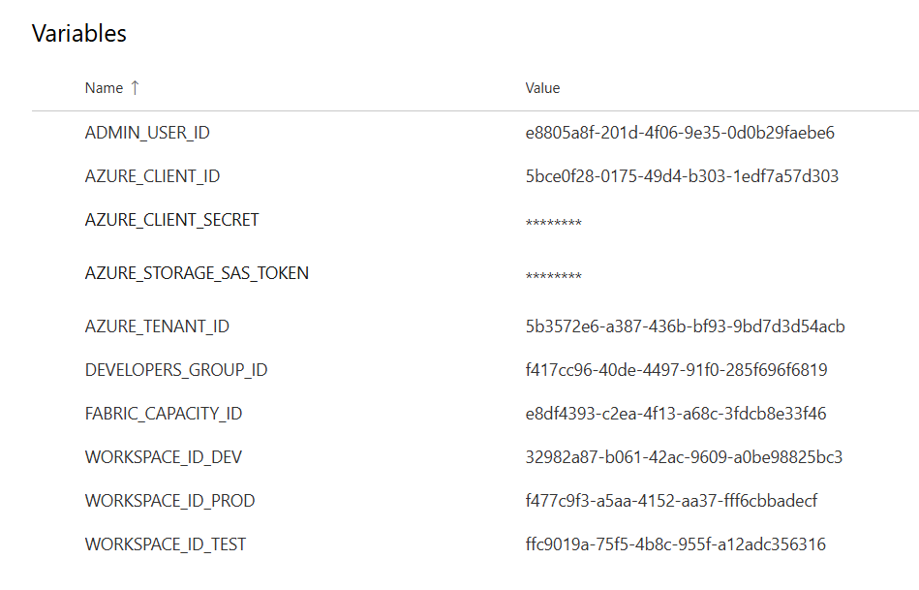

Slide 69
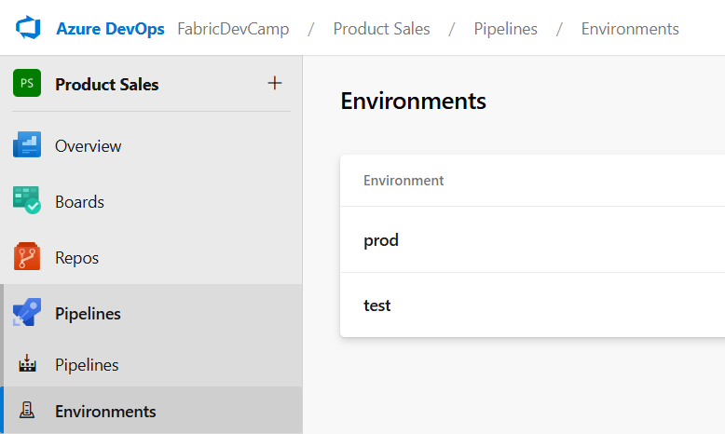

Slide 71
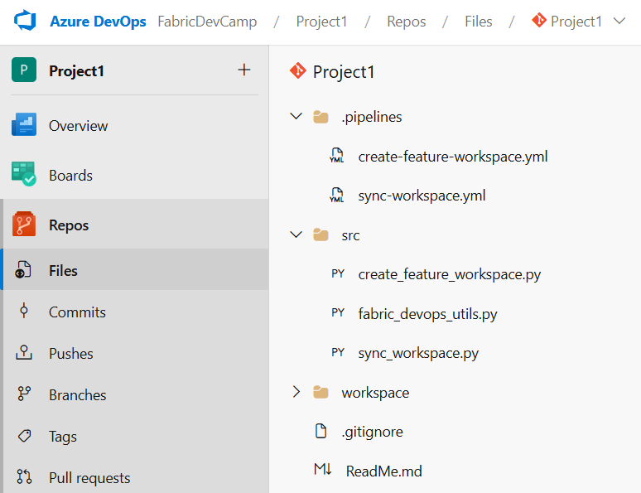

Slide 72
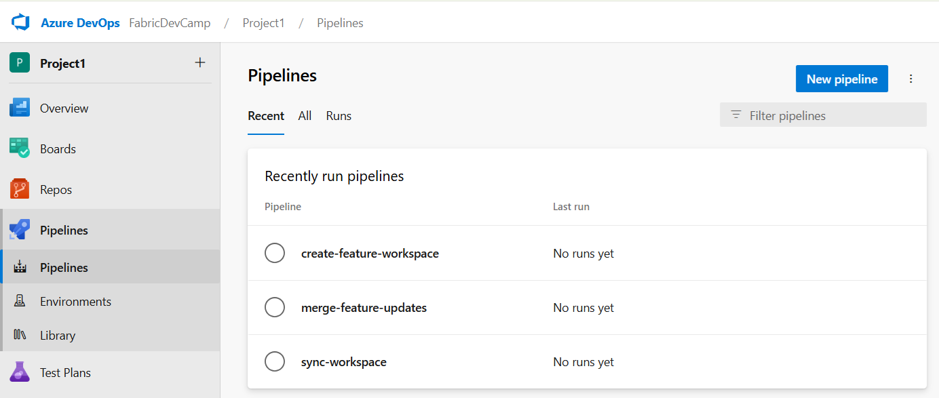

Slide 73
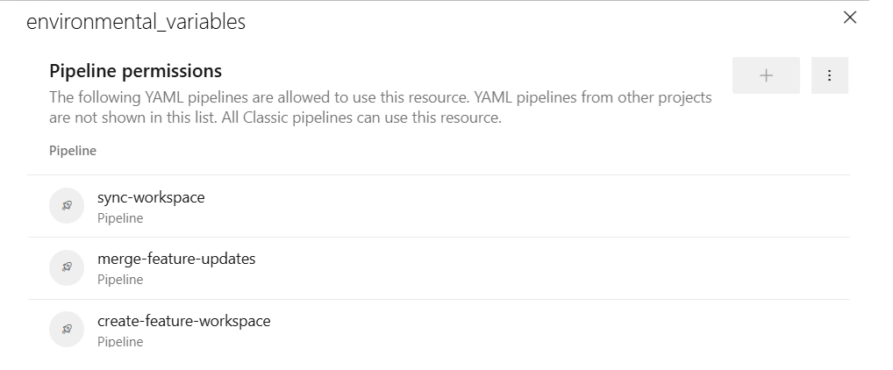

Slide 74
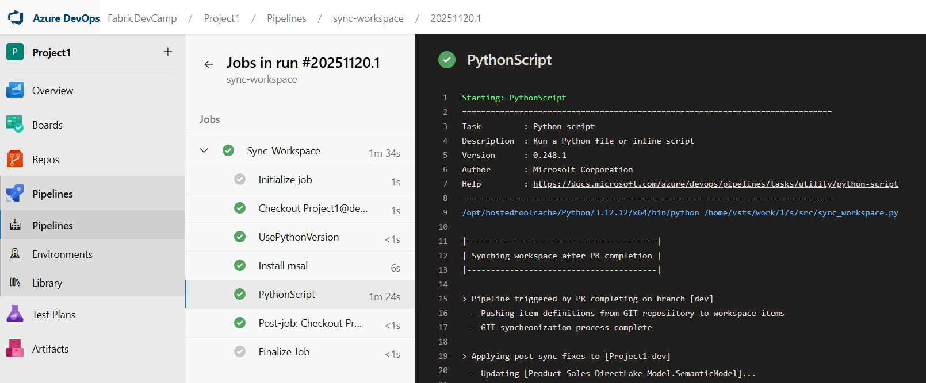

Slide 75
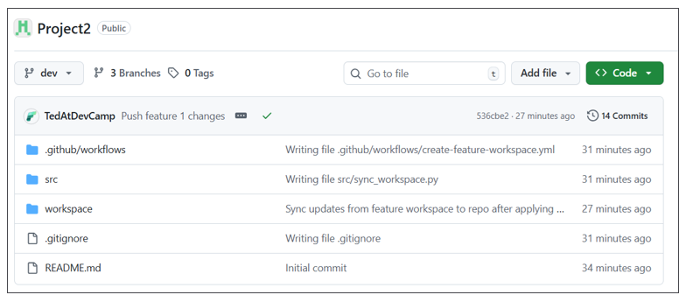

Slide 76


Slide 77


Slide 78


Slide 79


Slide 80


Slide 81
Dev Workspace
Test Workspace
Prod Workspace
Semantic Model
Report
Semantic Model
Report
Semantic Model
Report
Deploy
changes
Deploy
changes
Lakehouse
Notebook
Lakehouse
Notebook
Lakehouse
Notebook

Slide 82
feature workspace
dev workspace
prod workspace
Workspace Item
Workspace Item
Workspace Item
displayName | sales
type | Lakehouse
id | 11111111-1111-1111-1111-111111111111
displayName | sales
type | Lakehouse
id | 22222222-2222-2222-2222-222222222222
displayName | sales
type | Lakehouse
id | 33333333-3333-3333-3333-333333333333
feature workspace
dev workspace
prod workspace
Workspace Item
Workspace Item
Workspace Item
displayName | sales
type | Lakehouse
id | 11111111-1111-1111-1111-111111111111
logicalId | AAAAAAAA-AAAA-AAAA-AAAA-AAAAAAAAAAAA
displayName | sales
type | Lakehouse
id | 22222222-2222-2222-2222-222222222222
logicalId | AAAAAAAA-AAAA-AAAA-AAAA-AAAAAAAAAAAA
displayName | sales
type | Lakehouse
id | 33333333-3333-3333-3333-333333333333
logicalId | AAAAAAAA-AAAA-AAAA-AAAA-AAAAAAAAAAAA

Slide 83


Slide 84


Slide 85


Slide 86


Slide 87


Slide 88


Slide 91


Slide 92
prod
workspace
dev1
workspace
main
branch

Slide 93
prod
workspace
dev1
workspace
main
branch

Slide 94


Slide 95
prod
workspace
dev1
workspace
main
branch

Slide 96
existing
workspace
GIT
branch
Commit to GIT

Slide 97
dev
workspace
GIT connection
integration
branch
feature_1
workspace
GIT connection
feature_1
branch
feature_2
workspace
GIT connection
feature_2
branch
feature_n
workspace
GIT connection
feature_n
branch

